Slide 1

Sequential PLDs
by
Manikandan AVM
Assistant Professor, ECE, SRMIST, KTR

Slide 2
Sequential Programmable Devices
The combinational PLD consist only gates
Sequential Programmable Devices includes both gates and filp-flop
Type of sequential Programmable Devices:
Sequential (simple) programmable logic device (SPLD)
Field-programmable logic sequence (FPLS, defunct – too hard to use)
Registered PAL / macrocell structure
Complex programmable logic device (CPLD)
Collection of SPLDs on a chip
Field programmable gate array (FPGA)
Logic blocks (look-up tables, multiplexers, gates, flip-flops)
Programmable input/output blocks
Programmable interconnections

Slide 3
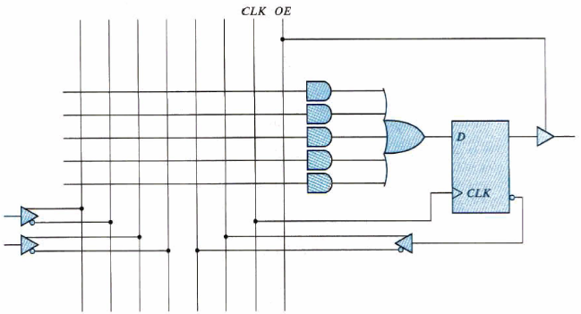
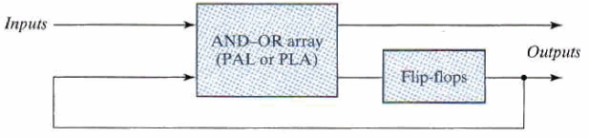
SPLD
SPLD: consist PAL and D flip-flop
Each section in SPLD is called Microcell
The basic microcell logic
AND-OR array
Edge-triggered D flip-flop
Three-state buffer(inverter)
A typical SPLD has from 8 to 10 macrocells within one IC package

Slide 4
The AND-OR array is exactly the same as the one found in the combinational PLD.
However, it has edge-triggered flip-flops between the AND-OR array and its outputs.
All of the flip-flops are connected to a common clock input CLK, and change state on the rising edge of the clock.
Each flip-flop drives an output pin through a 3- state buffer; the buffers have a common output-enable signal, OE_L.
Notice that the registered output pins contain the complement of the signal produced by the AND-OR array.
The connection from the D flip-flop outputs into the AND-OR array makes it easy to design shift registers, counters, and general state machines.
D flip-flop outputs are available to the AND-OR array whether or not the output three-state drivers are enabled. Thus, the internal flip-flops can go to a next state that is a function of the current state even when the outputs are disabled.

Slide 5
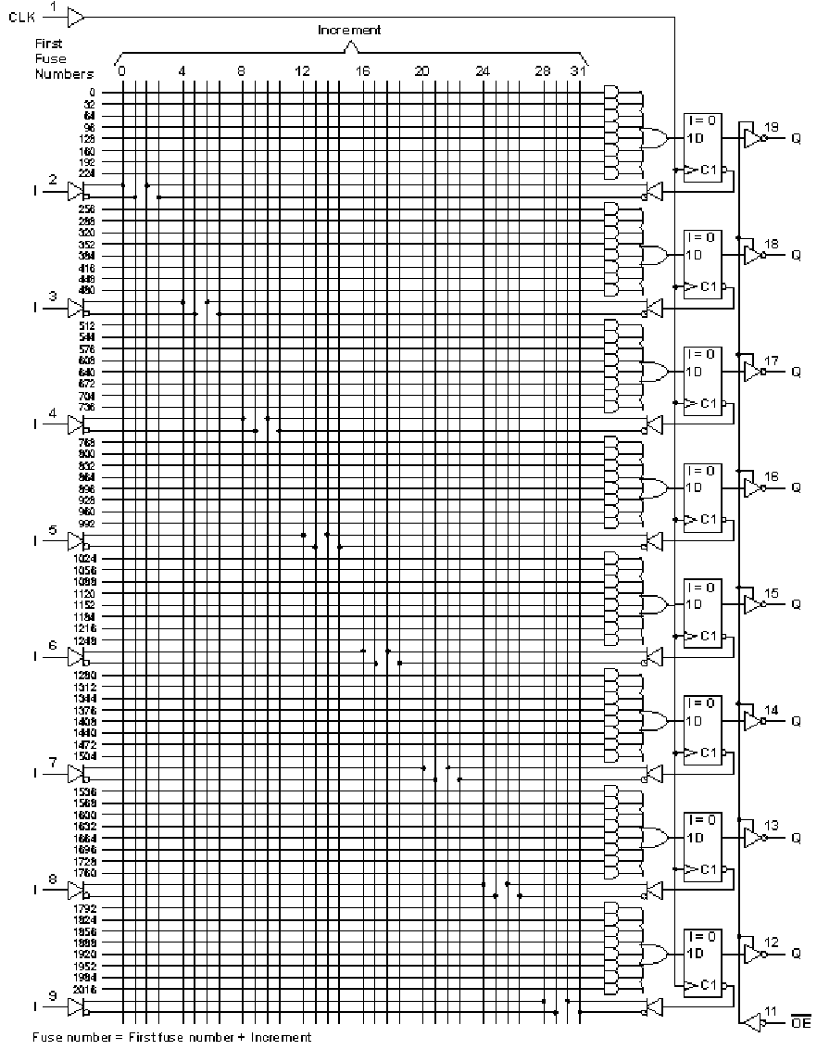
16R8 –sequential logic PAL
8 inputs, each with true & complement
8 outputs, each with
D flip-flop With feedback for FSMs
8 product terms that can AND any of:
8 inputs or their complements
8 feedbacks or their complements from D flip-flops
One clock for all FFs
One tri-state control for all outputs

